Slide 1
How do Gamers Feel?
Joshua Sonnen
sonnenj@wwu.edu

Slide 2
Original Data
TextBlob Generated
Mohamad Tarek performed a web scraping of Steam to pull user review data. There were a total of 762,851 reviews across 290 games.
Review Features
Recommendation (binary)
Hours Played
Funny votes
Helpful votes
Game Features
Game_name (290)
Publisher (173)
Developer (216)
overall_player_rating (11)
TextBlob is a Python NLP library. I use its sentiment analysis tool to generate additional features.
Review Features
Number of words
Number of sentences
Polarity [-1, 1]
Subjectivity [0, 1]
–“How opinionated the review is”
Notes:
Interesting Tasks
Subsets of my data: “high voted reviews”, “high hours_played”,
Game_name, developer, publisher are all variables to predict (from hours_played, funny/helpful votes, textblob data)
Predict recommendation from TextBlob generated data
How to use genre?
Multi-hot vector
Sklearn discretization of hours_played (for better accuracy)
Histograms
Recommend vs polarity and objectivity
Hours_played vs polarity and objectivity and length of review
Date vs frequency. (discover when this data was created)
2 graphs. 1 for recommend; 1 for not recommend

Slide 3
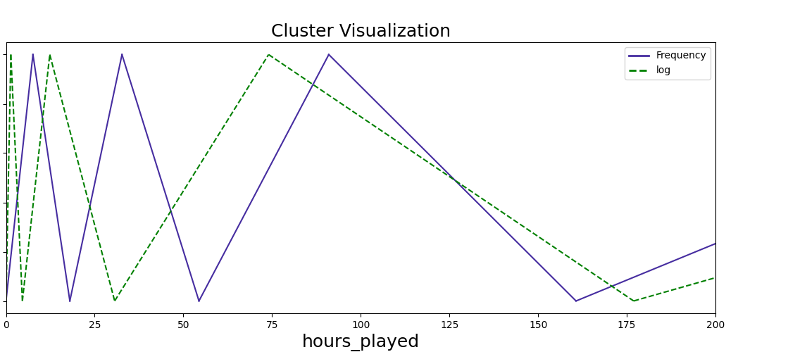
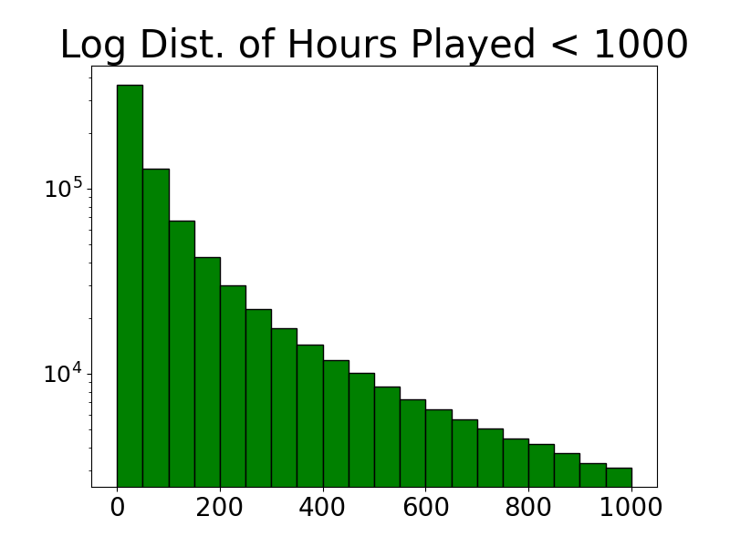
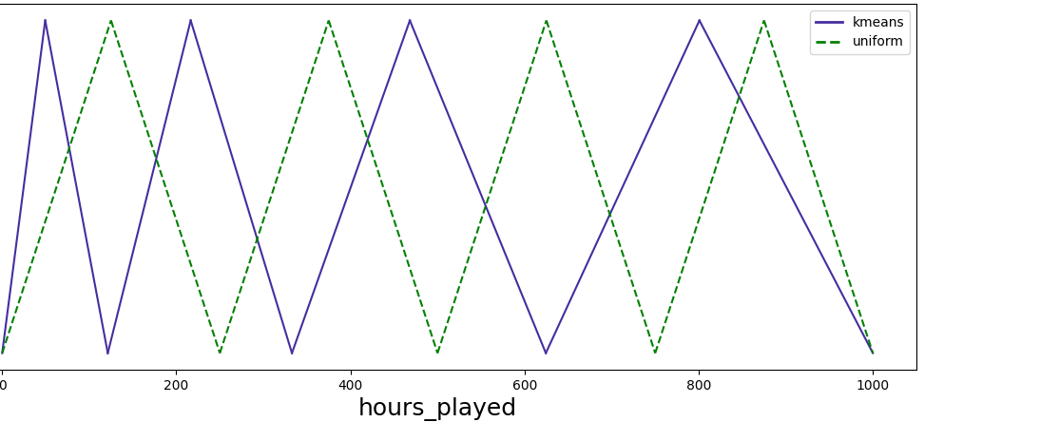
Hours Played Discretization Strategies
— Equal frequency
- - log(hours_played) then discretize by equal ranges
— K Means
Clustering
- - Equal ranges

Slide 4
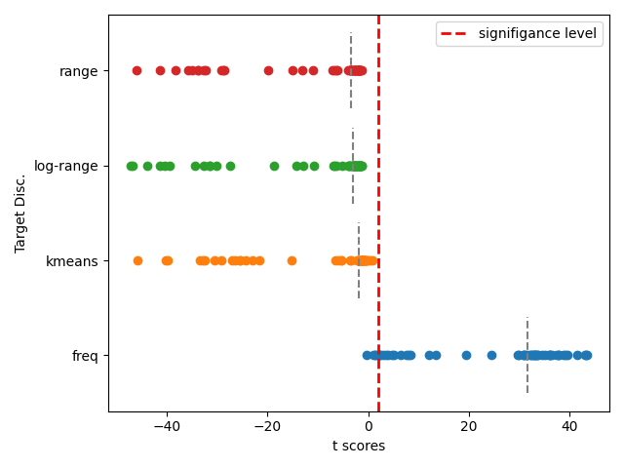
Target Discretization Analysis
Random Forest classifier.
Bootstrap factor of 3
11 feature subsets
4 split criteria: random, entropy, gini, log loss
4 discretization strategies: range, log-range, k-means, and frequency
Each t-score represents the difference in sample means b/w the majority classifier and the random forest. I use Welch’s t-test to correct for unequal population variance.
T_{critical} ≈ 2.04
Significance threshold
Target Disc.
Notes:
Polarity, objectivity
Just one hot them
All other values are just fine as is.
Euclidean_dist –
½ (||x - y||)^2 – onehot
Onehot or continuous mask
Euc dist norm. Can take the norm difference of a single element. Forbenius norm (1 norm). row sum | x-y |
Mean =
Std_error =
normalize inside euc dist method.

Slide 5
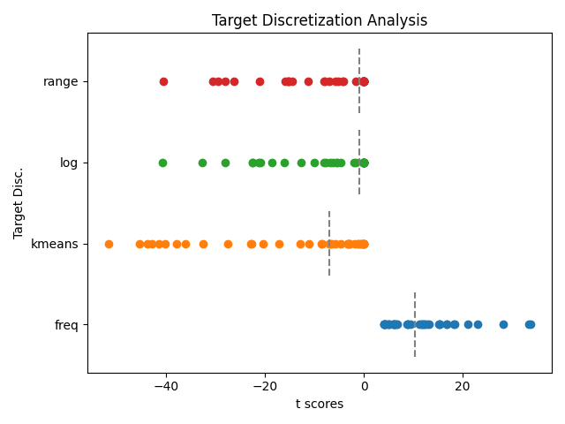
Target Discretization Analysis
K Neighbors classifier
Bootstrap factor of 3
5 feature subsets
4 bin sizes
2 choices of k
Each t-score represents the difference in sample means b/w the majority classifier and the classifier. I use Welch’s t-test to correct for unequal population variance.
T_{critical} ≈ 2.04
Significance threshold

Slide 6
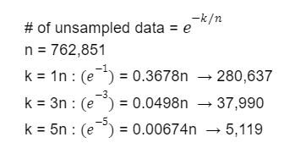
Bootstrapping
With 760,000 data points, my first step is to remove some data
Sample with replacement. These indices are dropped
Set difference → Return not sampled indices
80% train; 20% validation split
Sampling k points on the range (0, N) I will expect
For K Nearest Neighbors classification, I use a bootstrap factor of 3.
For Random Forest classification, I use a bootstrap factor of 5.

Slide 7
Bin Sizes

Slide 8
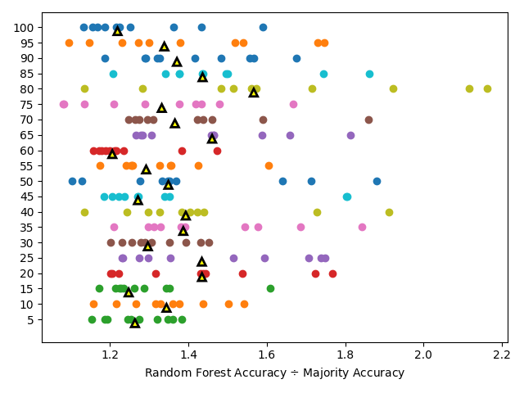
Random Forest
Bootstrap factor of 3
All features
Random split criterion
Max depth = 5
# Trees = 10
Classification becomes more difficult with more categories. My goal is to find a bin size which hours played will naturally cluster into.
Group Size

Slide 9
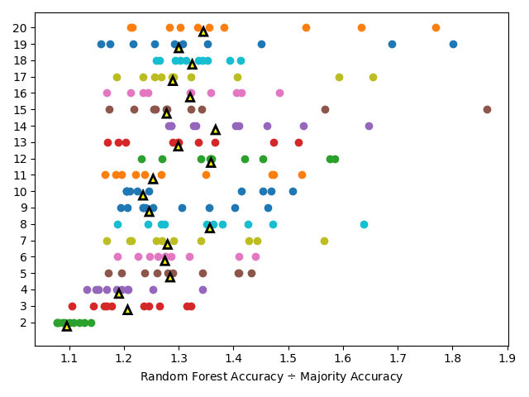
Random Forest
Bootstrap factor of 3
All features
Random split criterion
Max depth = 5
# Trees = 10
Detailed look at the first 20 group sizes. I observe a fall-off in median classifier performance at 8.
Group Size

Slide 10
2 Clustering– Motivated Clustering Bin Sizes
For each continuous attribute:
For each category:
Cluster into 8 groups
Calculate Silhouette score
Cluster each subgroup into 2 groups using k means clustering
Evaluate cluster using silhouette score
Continuous variable | Hours played | Helpful votes | Funny votes | Number of words | Number of sentences | Polarity | Subjectivity
Group Size | 9 | 11 | 10 | 9 | 10 | 11 | 11

Slide 11
Feature Subsets

Slide 12
Random Forest Parameters
Each trial is ran 30 times to provide enough samples for t-testing
Bootstrap factor of 5.
Ensemble 100 trees
Max Features = # features
Bin size = 8
Criteria
Entropy
Gini Index
Log loss
Random
Target Disc
Uniform
K means
Frequency
Equal range on log(hours_played)
Nine Hopeful Subsets
game_name, overall_player_rating
publisher, overall_player_rating
developer, overall_player_rating
game_name, publisher, developer, overall_player_rating
recommendation/hours played, game_name, overall_player_rating
recommendation/hours played, publisher, overall_player_rating
recommendation/hours played, developer, overall_player_rating
recommendation/hours played, game_name, publisher, developer, overall_player_rating
All categorical AND continuous features.
Notes:
Polarity, objectivity
Just one hot them
All other values are just fine as is.
Euclidean_dist –
½ (||x - y||)^2 – onehot
Onehot or continuous mask
Euc dist norm. Can take the norm difference of a single element. Forbenius norm (1 norm). row sum | x-y |
Mean =
Std_error =
normalize inside euc dist method.

Slide 13
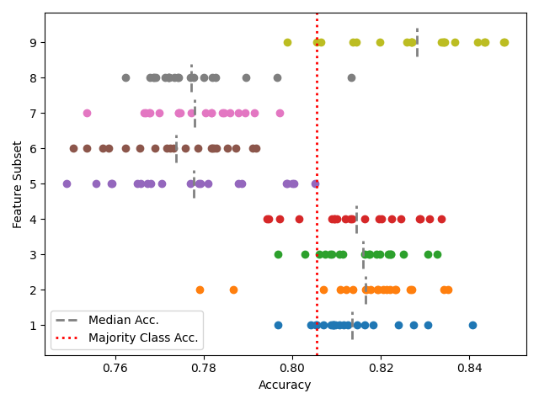
Predict Recommend– Feature Subset Analysis
– Random Forest
– Random split criterion
Feature subsets 5-8 are the same as 1-4 except they also have hours played as a feature. It is unusual for the addition of a feature to hinder prediction capabilities.
Hours played is a continuous feature. Perhaps the continuity makes it difficult to split.
Feature Subset

Slide 14
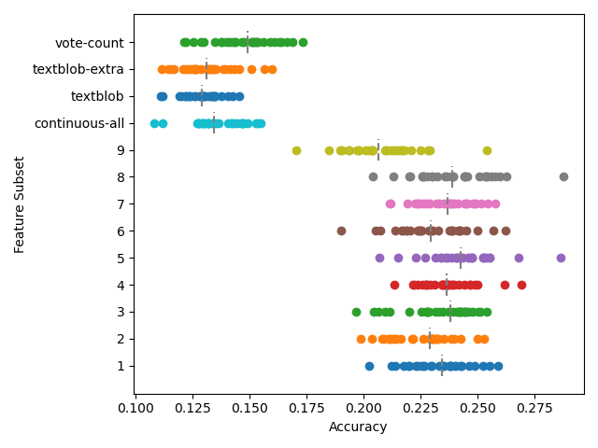
Predict Hours Played– Feature Subset Analysis
Recommendation does not have an influence on the classifying performance for predicting hours played.
The 4 worst performing feature groups are all continuous features, supporting my hypothesis that continuous features hinder Random Forest classification.
Feature Subset

Slide 15
TextBlob Features

Slide 16
Trial 1: TextBlob Features
TextBlob Groups
TextBlob 1 – 'num_words'
TextBlob 2 – 'num_sentences'
TextBlob 3 – 'polarity'
TextBlob 4 – 'subjectivity'
TextBlob_length – 'num_words', 'num_sentences'
TextBlob_sentiment – 'polarity', 'subjectivity'
TextBlob_pair1 – 'num_words', 'polarity'
TextBlob_pair2 – 'num_words', 'subjectivity'
TextBlob_pair3 – 'num_sentences', 'polarity'
TextBlob_pair4 – 'num_sentences', 'subjectivity'
TextBlob_all – 'polarity', 'subjectivity', 'num_words', 'num_sentences'
Bootstrap factor of 5.
Each trial is ran 30 times to provide enough samples for t-testing
Ensemble 10 trees
Max Features = # features
Criteria
Entropy
Gini
Log
Random
Notes:
Polarity, objectivity
Just one hot them
All other values are just fine as is.
Euclidean_dist –
½ (||x - y||)^2 – onehot
Onehot or continuous mask
Euc dist norm. Can take the norm difference of a single element. Forbenius norm (1 norm). row sum | x-y |
Mean =
Std_error =
normalize inside euc dist method.

Slide 17
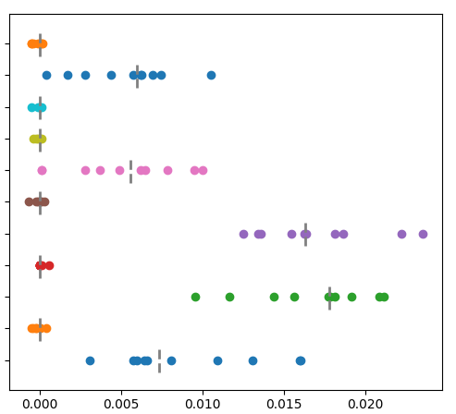
Predict Recommendation using TextBlob
Difference b/w Majority and Random Forest Accuracy
Features
subjectivity
polarity
# sentences
# words
polarity, subjectivity
# sentences, subjectivity
# sentences, polarity
# words, subjectivity
# words, polarity
# words, # sentences
All 4 features
– Random Forest
– Random Split
– Max Depth = 5
– Bootstrap factor of 3
Polarity seems to be the best TextBlob feature to predict recommendation.

Slide 18
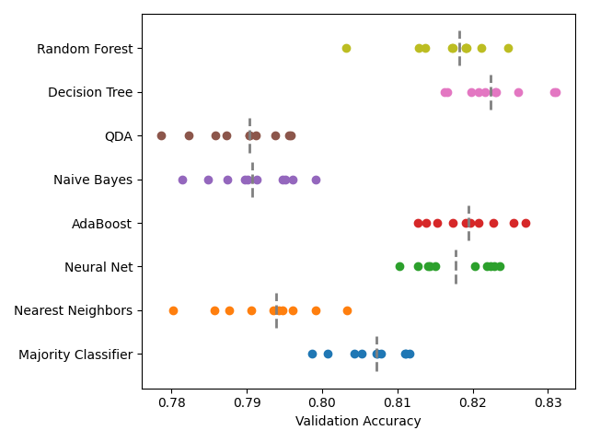
Predict Recommend– TextBlob Classifier Analysis
– # words, # sentences,
polarity, subjectivity
These classifiers do not achieve state-of-the-art performance. Later, you will see accuracy up to 87% using all features.
Classifier Choice

Slide 19
All Classifiers

Slide 20
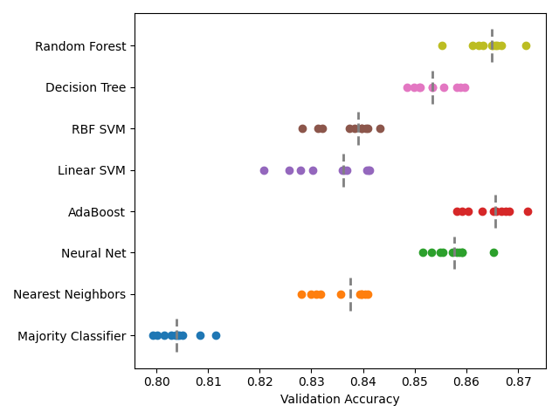
Predict Recommend– Classifier Analysis
– All features
– Bootstrap factor of 3.
– Sensible classifier parameters.
QDA and Naive Bayes performed below 60% accuracy.
Classifier Choice

Slide 21
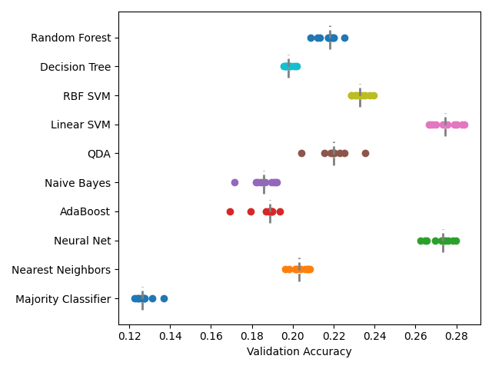
Predict Hours Played– Classifier Analysis
– All features
– Bootstrap factor of 3.
– Sensible classifier parameters.
All classifiers improved over the Majority.
Classifier Choice

Slide 22
Test Set Evaluation

Slide 23
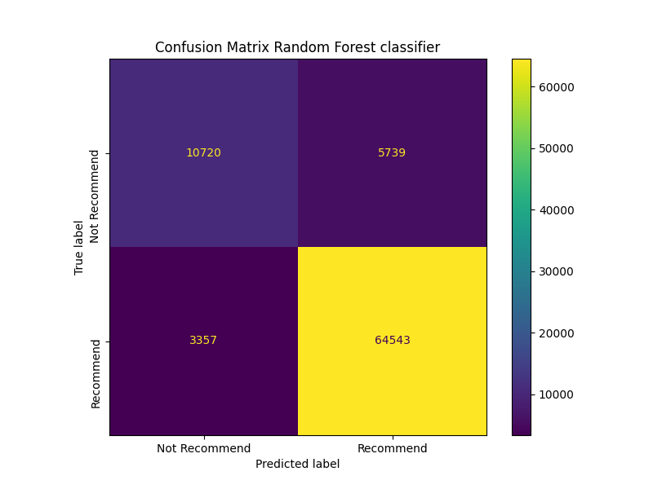
Test Set Evaluation
Predict Recommendation
Classifier Accuracy– 89.22%
Majority Class Accuracy– 80.49%
8.73% Improvement
Random Forest
Split Criterion = Random
# Trees = 100
Feature Subset = ALL
hours_played, game_name, publisher, developer,
overall_player_rating, Helpful, funny, num_words,
num_sentences, polarity, subjectivity

Slide 24
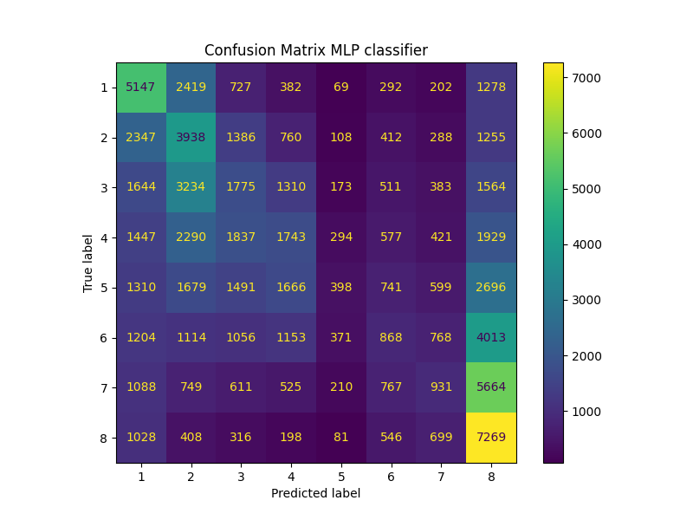
Test Set Evaluation
Predict Hours Played
Classifier Accuracy– 26.16%
Majority Class Accuracy– 12.49%
13.67% Improvement
Neural Network– MLP Classifier
Alpha = 1 ; max_iter = 1000
Discretization Strategy = equal frequencies
Group Size = 8
Feature Subset = ALL
hours_played, game_name, publisher, developer,
overall_player_rating, Helpful, funny, num_words,
num_sentences, polarity, subjectivity

Slide 25
Future Expansions
I only analyzed feature subsets for Random Forest and K Nearest Neighbors. Expand search to other classifiers.
Group size of 8 is an arbitrary choice. Anywhere in the range [2, 40] could be an acceptable choice for group size. Or use a model capable of regression.
Utilize Associative Rule Mining techniques to find optimal feature subsets. I brute forced a subset of feature groupings, but this only extended to TextBlob combinations (excluding triplets) and 9 arbitrary groupings.

